Slide 1

FOR LOOP

Slide 2
WHY FOR LOOP
IN THE BELOW IMAGE ,THE BOXES ARE OPENED ONE AFTER THE OTHER MANUALLY.
Notes:
Explain how the boxes are opened. “We have to click on each of those boxes manually to open”.
ASK THE BELOW QUESTION
Is it necessary to click on the boxes repeatedly to open them ?
OR
Can we open all the boxes all at once?

Slide 3
WHY FOR LOOP
LETS SAY THERE ARE 100 BOXES.
THAT MEANS, 100 BOXES SHOULD BE OPENED MANUALLY WHICH WILL CONSUME A LOT OF TIME.
TO AVOID REPEATING A CERTAIN TASK, WE USE FOR LOOP
FOR N NUMBER OF TIMES:
PERFORM A TASK
Notes:
Explain the concept of FOR loop with help of example mentioned in the slide.

Slide 4
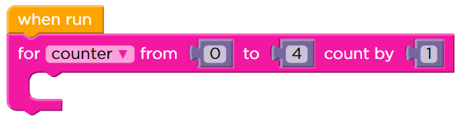
HOW TO USE FOR LOOP
IMAGINE THAT YOU ARE A SCUBA DIVER, AND YOU ARE PLANNING A DAY-LONG TRIP TO A NEW LOCATION. YOU ARE CHECKING OUT A NEW REEF, SO YOU WILL PROBABLY WANT TO TAKE MULTIPLE TRIPS TO THE BOTTOM TO MAKE SURE YOU SEE ALL THE CORAL AND MARINE LIFE.
LET US USE FOR LOOP TO TAKE MULTIPLE TRIPS
Notes:
Here is another example through which students will understand the syntax of for loop.

Slide 5

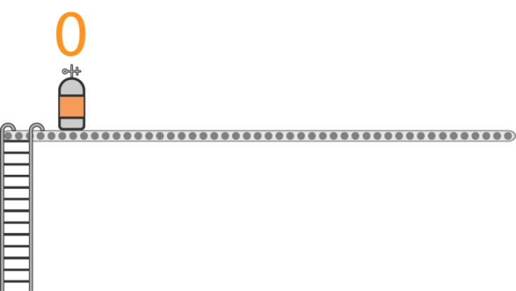
HOW TO USE FOR LOOP
BEFORE YOU START YOUR DIVE, YOU NEED TO DETERMINE HOW MANY OXYGEN TANKS YOU WILL NEED OVER THE COURSE OF THE DAY.
THIS IS THE INITIALIZATION. IT TELLS YOU THE VALUE OF THE FIRST OXYGEN TANK. IN THIS CASE, YOU START AT TANK 0.
Notes:
In next few slides INITIALIZATION, CONDITION , and INCREMENTATION is explained with the help of Scuba Diving example.

Slide 6

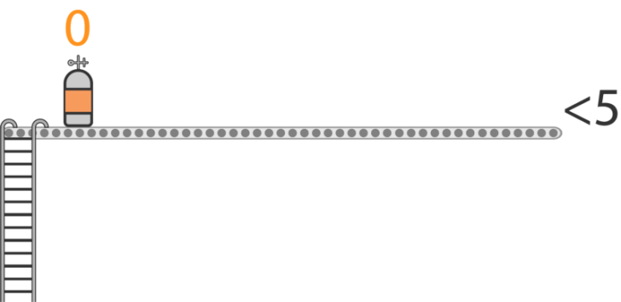
HOW TO USE FOR LOOP
THIS IS THE CONDITION. IT IS THE MAXIMUM CAPACITY OF THE BOAT. YOU CAN ONLY ADD 5 OXYGEN TANKS.

Slide 7

HOW TO USE FOR LOOP
SETTING UP OXYGEN TANKS (UPDATE)
SO FAR, WE KNOW THAT OUR FIRST OXYGEN TANK HAS A VALUE OF 0, AND THE LAST ONE MUST BE LESS THAN 5. BUT HOW MANY TANKS DO YOU NEED TO PREPARE?
IT MEANS THAT EVERY TIME WE FINISH A LOOP, WE WILL ADD 1 TO COUNTER.

Slide 8
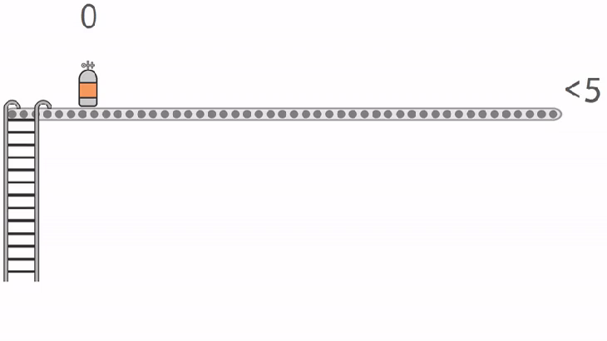
HOW TO USE FOR LOOP
We continue to add oxygen tanks until we hit the limit. When we add one tank at a time, the last value that fulfills the condition is 4.

Slide 9
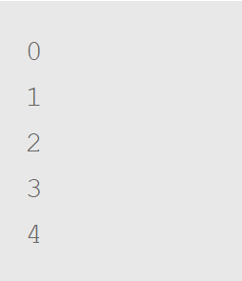
HOW TO USE FOR LOOP
CODE
Values for COUNTER

Slide 10
ACTIVITIES
TEACHER ACTIVITY1:
HTTPS://STUDIO.CODE.ORG/S/COURSEF-2020/LESSONS/15/LEVELS/4
TEACHER ACTIVITY2:
HTTPS://STUDIO.CODE.ORG/S/COURSEF-2020/LESSONS/15/LEVELS/5
TEACHER ACTIVITY3:
HTTPS://STUDIO.CODE.ORG/S/COURSEF-2020/LESSONS/16/LEVELS/4

Slide 11
ACTIVITIES
STUDENT ACTIVITY1:
HTTPS://STUDIO.CODE.ORG/S/COURSEF-2020/LESSONS/15/LEVELS/6
STUDENT ACTIVITY2:
HTTPS://STUDIO.CODE.ORG/S/COURSEF-2020/LESSONS/15/LEVELS/6
STUDENT ACTIVITY3:
HTTPS://STUDIO.CODE.ORG/S/COURSEF-2020/LESSONS/16/LEVELS/5

Slide 12
THANK YOU

